Slide 1
Overview
What is a Thread?
Thread is a basic unit of code having separate execution path with in the program.
Thread helps to perform multiple tasks at the same time with in the program.
What is process??
Execution of an Application is nothing but process.
A Process that is executed with one thread is known as “single thread process” or “single thread application”
or
A Process that is run with two or more threads known as “multi thread process” or “multi thread application”

Slide 2
Overview (Contd..)
.NET runtime CLR can manage more than one thread using “Thread support service.” This makes .NET support multithreading.
To Develop Thread based application .Net comes with Built in Library System. Threading
Classes Under System. Threading
Thread
Monitor
ThreadPool
Timer

Slide 3
Overview
What is Multitasking??
Multitasking is a process of running multiple Application processes at a time.
Reading New paper
Have a coffee Multi Tasking
Taking with friend
etc.
Ex: A O/S Simultaneously run msword,ie,.net app etc.
The main advantage of Multi Threading is improving app performance.
Person

Slide 4
About Thread class
By default CLR will create a thread for any .NET app that thread is called “Main Thread”
Note: A C# client program (Console, WPF, or Windows Forms) starts in a single thread created automatically by the CLR and operating system (the “Main” thread), and is made multithreaded by creating additional threads.
We can create other threads in the program by using the Thread class. Such Threads are called child threads.
To work with threads C# provide a Thread class.
Thread class under System. Threading Library.
Declaration:
Thread t=new Thread(address of a subprogram)
Note: Thread class is sealed so it cannot be inherited.

Slide 5
About Thread class
The Thread class has following constructors, to maintained reference of method
public Thread(ThreadStart start);
public Thread(ParameterizedThreadStart start);
public delegate void ThreadStart();
Thread t=new Thread(new ThreadStart(method-name))
ThreadStart Delegate is defined with zero parameters so that method passed to ThreadStart should not have parameters
public delegate void ParameterizedThreadStart (object obj);
Thread t=new Thread(new ParameterizedThreadStart (method-name))
ParameterizedThreadStart Delegate is defined with one parameter with object type so that method passed to ParameterizedThreadStart should have one parameter with object type

Slide 6
Thread Methods and Properties
Thread Class come up with various methods and properties to control the execution of threads.
Start()-it will start thread execution.
Start(object obj): This is Required when we pass a argument to thread
Sleep(int millisecondsTimeout) :it will stop thread execution for specified mille secs
Sleep(TimeSpan timeout): Timespan can allow timeout in the form of min-hours secs etc.
Suspend()-it will suspend thread execution[if the thread is already suspended, has no effect.]
Resume()-it will start thread execution, that has been suspended[i.e. it starts the suspended threads]
Abort()-it will terminates thread execution, once thread is aborted it will not be started[compile will rise the Thread exception]

Slide 7
Passing information to the thread methods
Property:
CurrentThread:Gets the current running thread object.
IsAlive:Gets execution status of current thread. It Return true when the thread is running else returns false.
Name: Gets or sets the name of the thread.
Priority: Gets or sets a value to scheduling priority of a thread.
Each thread has a priority setting associated with it.
A threads priority determines, how much CPU time a thread receives relative to other currently executing threads.
Low priority threads receives little CPU time. High priority threads a lot.
t.Priority= ThreadPriority.Highest
ThreadPriority.Above normal
ThreadPriority.Normal
ThreadPriority.Below normal
ThreadPriority.Lowest

Slide 8
Thread Methods and Properties
ThreadState:Gets a state of the current thread.
Thread State | Description
Unstarted | Thread is Created within the common language run time but not Started still.
Running | After a Thread calls Start method
WaitSleepJoin | After a Thread calls its wait or Sleep or Join method.
Suspended | Thread Responds to a Suspend method call.
Stopped | The Thread is Stopped, either normally or Aborted.

Slide 9
Passing information to the thread methods
Using delegate ParameterizedThreadStart
Thread t=new Thread(new ParameterizedThreadStart (method-name))
ParameterizedThreadStart requires the method that has a parameter of type object and return void.

Slide 10
Some more members of Thread
IsBackground Property:
.Net Framework defines two types of threads foreground and background threads.
By default, a thread is created as a foreground thread.
Changing foreground thread to background thread we use IsBackground property
public bool IsBackground{ get; set;}
IsBackground is true for background threads and false for foreground threads
The only difference between two is that the process won’t end until all of its foreground threads have ended, but background threads are terminated automatically after all foreground threads are stopped.
Join()-> Called on a thread object which makes other threads wait until the current thread finishes its task. Or terminates.

Slide 11
Synchronizing Threads
Synchronization is a process of coordinating the activities of two or more threads when they are sharing the same recourses.
When two or more threads run on the same object’s method and share the same instance members, but that can be used by only one thread at a time.
Synchronization is supported by the keyword lock, which controls to access block of code with in an object
When an object is locked by one thread ,no other thread can gain access to the locked block of code.
When the thread releases the lock, the code block is available for use by another thread.

Slide 12
Synchronizing Threads
The General form of lock:
lock(object) lock(this)
{ {
//statements to be synchronized //statements to be synchronized
}
}
To lock static members
lock (typeof(Class))
{
}
If u want to synchronize only a single statement, the curly braces are not needed.
A lock statement ensure that the section of code protected by the lock for the given object can be used only by the thread that obtains the lock.
All other threads are locked until the lock is removed.
Other threads trying to acquire the lock on the same object will enter a wait state until the code is unlocked.
The lock is removed when the block is exited.

Slide 13
Monitor class
Another way of implementing synchronization is using Monitor class.
Monitor class is defined in System. Threading namespace.
The C# lock keyword is just a notation for using System.Threading.Monitor class type.
The lock scope actually resolves to the Monitor class after being processed by the C# compiler.
Monitor defines several methods that control or manage synchronization.
Enter(object Syncobj): obtain the lock on an object.
Exit(object Syncobj): To Release the lock on object.
TryEnter(object Syncobj): It returns true if the calling thread obtains a lock on Syncobj
Wait()
Pulse()
Pulseall()

Slide 14
Monitor class
The Wait(),Pulse(),PulseAll() methods can be called only from within a locked blocked code
Wait(): Releases the lock on an object in order to permit other threads to lock and access the object. The calling thread waits while another thread accesses the object. Or
Releases the lock on an object and blocks the current thread until it reacquires the lock.
Pulse(): Sends a signal to waiting thread. The signal notifies a waiting thread that the state of the locked object has changed, and the owner of the lock is ready to release the lock. Or
A Call to Pulse() start the first thread in the queue of threads waiting for the lock.
PulseAll(): Signals the release of the lock to all waiting threads

Slide 15
Thread Pool
Thread pool is a collection of threads that can be used to perform a number of tasks in the background.
Once a thread in the pool completes its task, it is returned to a queue of waiting threads, where it can be reused.
Note that all the thread pool threads are background threads. You cannot change the pool thread to foreground thread.
Thread pools typically have a maximum number of threads. If all the threads are busy, additional tasks are placed in queue until they can be serviced as threads become available.
we can implement our own thread pool, with .Net Framework
Thread pool is a class under System.Threading Namespace
This class uses entirely static methods –there is a single pool of threads for the entire application
They are mainly employed in server applications.

Slide 16
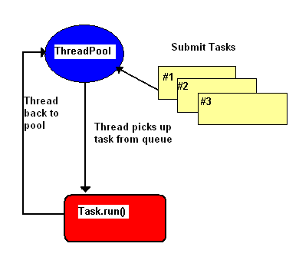

Slide 17
Timer
Threads can also be scheduled to execute at certain time intervals. This is supported by the Timer class in the .NET environment.
The Timer class's constructor is used to create a timer object. The constructor is overloaded. Public Timer() Public Timer(double)
Sets the interval property to the specified

Slide 18
Timer members
Tick
This event occurs when the Interval has elapsed.
Start
Starts raising the Tick event by setting Enabled to true.
Stop
Stops raising the Tick event by setting Enabled to false.
Close
Releases the resources used by the Timer.
AutoReset
Indicates whether the Timer raises the Tick event each time the specified Interval has elapsed or whether the Tick event is raised only once after the first interval has elapsed.
Interval
Indicates the interval on which to raise the Tick event.
Enabled
Indicates whether the Timer raises the Tick event.

Slide 19
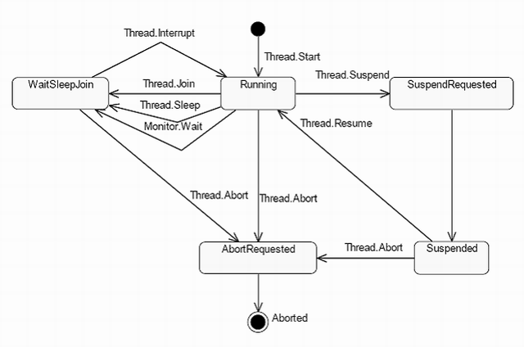

Slide 20
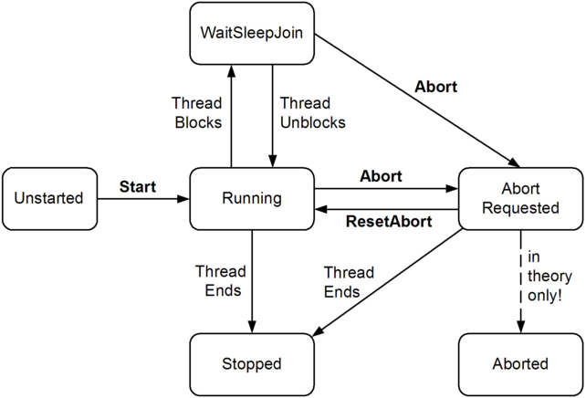

Slide 21
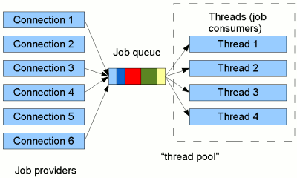

Slide 22
ThreadPool
The number of threads dynamically changes according to the workload on the threads in the pool.
Work items can return a value.
A work item can be cancelled if it hasn't been executed yet.
The caller can wait for multiple or all the work items to complete.
The state object that accompanies the work item can be disposed automatically.
Work item exceptions are sent back to the caller.
Work items have priority.
Work items group.
The caller can suspend the start of a thread pool and work items group.
Threads have priority.
Silverlight is supported.

